Slide 1


DESIGNING AND DEVELOPING A CROSS PLATFORM ONLINE BUS BOOKING TICKET SYSTEM
(A case study of Ndola bus terminus)
BY NAME COMPUTER No
Geoffrey Zimba 1913622
Chilufya chimfwembe 1913606
David nsofwa 1913669
Patricia chewe 1913636
Ndashe mwansa 1914070

Slide 2
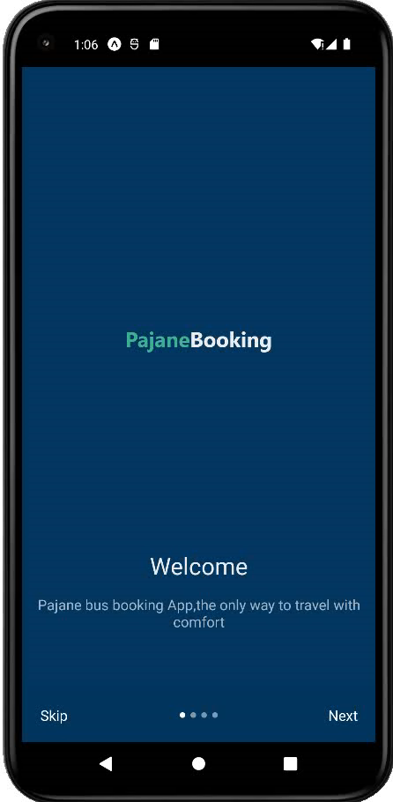
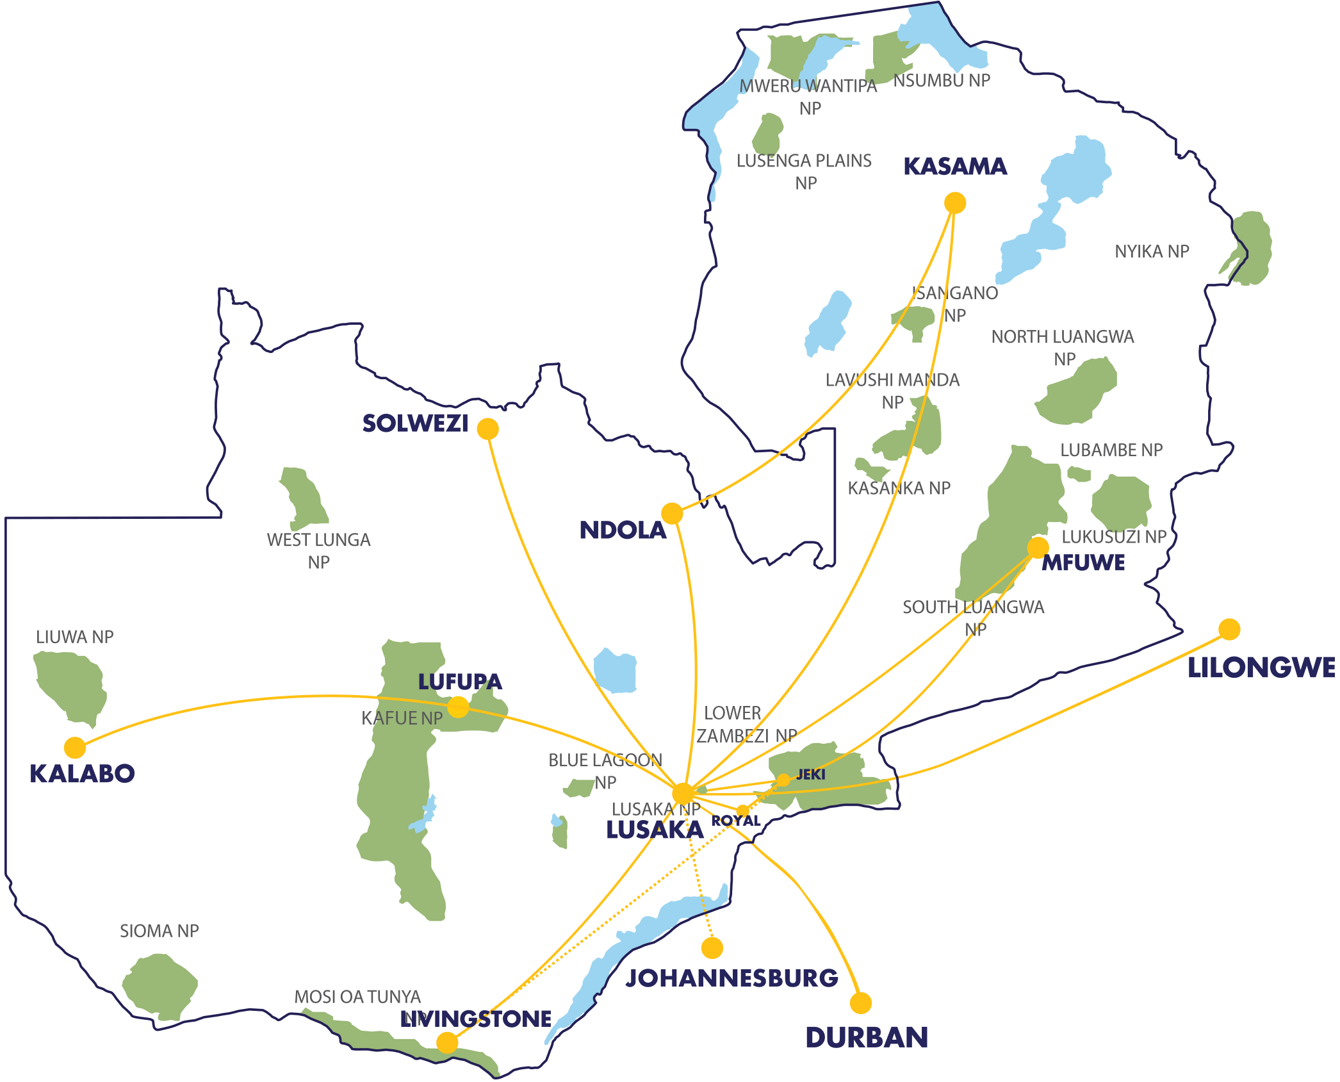
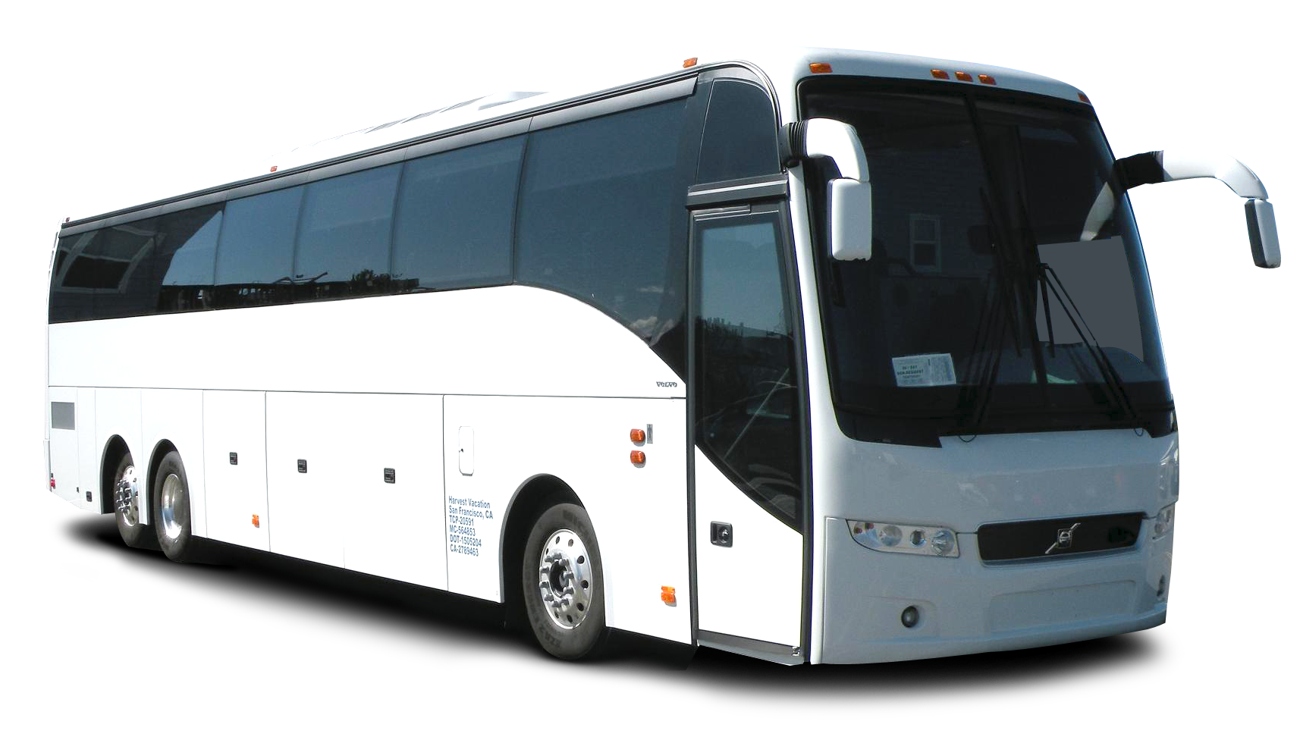
PAJANEBOOKING

Slide 3
Table Of Content

Slide 4
Introduction and Background
Following the creation of the Ministry of Transport and logistics and the ministry of information technology in 2021, our interests emerged for the development of a system that can take advantage of the explosive growth of e-commerce and the transport sector. In the modern day and age, internet has become an essential for everyone. This project focuses on the analysis and creation of a mobile applications for online bus ticket sales and purchases, ticket cancellations, postponements, report generation, and other functions for customers (passengers) and staff. Online Bus Booking System is a mobile application based Online Bus Booking System.

Slide 5
Cont…
This is a user friendly online bus ticket booking system for both clients and bus operators. Which also serves as a management tool for bus ticketing firms to successfully run their business. The application is a an evident way to sustain the vision 2030 of the Zambian constitution which is aimed at creating an E-Zambia, and our area of interest is in combating the effectiveness of the overseen vision through the transport and logistics sector under the minister Hon Frank M. Tayali.
An application that is cross platform, easy to use, lite and efficient in providing a platform for Booking, reserving and ticketing of bus seats for

Slide 6
Problem statement
The system that is used by the diversity at the counter currently is a manual system and is just used to sell bus tickets at the counter. A customer should go to the counter to buy a bus ticket or ask for the bus schedule. Furthermore, customers need to pay cash when they buy the bus ticket and sometimes need to queue up for a long period of time in order to get a bus ticket. Inflexibility in comparing prices between bus logistics at a particular bus terminal and Inaccurate timing between bus arrival and departure. Besides that, passengers are also not allowed to buy bus tickets through an online system. In addition, there is no single purpose online bus ticket booking system in Zambia for ticket booking which is seemlessly running on cross plartforms (Android and IOS devices).

Slide 7
Research Objectives
To develop a cross platform bus booking Ticket system.
To integrate Google maps APIs to reduce the time complexity of booking a bus ticket at bus terminus in zambia.
To integrate multiple payment methods in the cross platform bus booking ticket system.

Slide 8
Research Questions
While the research is being undertaken, a mirror of research questions has been identified using the objectives specified in this proposal.
How a cross platform system can enhance booking seats of local buses in Zambia?
How can Google maps APIs help reduce the time complexity of the manual processes of booking tickets at bus terminus in Zambia?
What payment options are suitable to provide flexibility to bus ticket booking to customers in Zambia?

Slide 9
Scope of the Research
This research focuses on two parties which are the bus operators and the customers on which the study was conducted in Ndola, Zambia Ndola bus terminus. After all data was collected and analyzed, it was seen that the system can be adopted by a number of transport and logistic companies operating around the provinces of Zambia, from Lusaka to Copperbelt and other provinces. Its scope can be designed to facilitate the local companies and travelers of Zambia. The system will be equipped with components to login/register, search, view, book and make payment on the application/web portal while providing a custom

Slide 10
Cont...
user-friendly interface on both platforms (android application and web site). the following are some elicited functional requirements.
In which the android/IOS application will be sitting on React Native and Node.js as back-end language and MySQL as the database management system.

Slide 11
Cont…
System Functional requirements
1. Admin/user login on web site
2. User login/registration on website / Mobile application
3. Search component (search by bus name, time, destination and current location)
4. Support viewing a live location of buses registered on the platform through the use of Google maps APIs.
5. Issue tickets and provide a qr code for each ticket number
6. Alerting and Notification for booked and next departures.
7. Booking and cancellation of advance tickets
8. Online payment visa/ Mastercard gateways including Mobile money services.
9. Live Tracking of Booked Bus

Slide 12
Literature Review
Many systems around the globe have been created to sustain the main objectives of bus booking and seat reservation through different technologies such as mobile applications, web applications and papers related to advocating for electronic payments of fares using electronic means.
And based on our research conducted we have outlined a number of systems and articles related to the underlined project topic.
All1Zed being one similar project
Ulendo and Pajane being a related system but for Taxi Rides
WebTickets for flight Tickets

Slide 13
Reviewed Work
S.no | Title | Year | author | Objectives | gaps
1 | Online Transport Booking System | 2021 | Prof. M. Chavan, Navarange Prajwal | To make sure that users could make their online booking or bookings to their desired transport companies with facilities provided by the new system. | The system made no live map to track the movement of Buses.
2 | online ticket booking | 2014 | Canlas, Katrina | The commuters can book bus ticket through online as long as they are connected to the Internet using their android phone(www.pinoytravel.com.ph). | the system was only limited to android mobile phone.
3 | E-Ticket Reservation System | 2014 | Harris, and Patterson | The main feature for this was the electronic storage of tickets sold and the uniform, accurate and centralized bus fare collection prizes(www.iiste.org). | The system made no live map to track the movement of Buses.

Slide 14
4 | ulendo | 2021 | Brenda jones | To allow for booking of rides through a cross platform mobile application using the google api Algorithms of nearest ride | The system is limited to booking taxi only
5 | Promoting Cashless Payment System for Public Transport Sector to Combat Covid-19 in Kenya | 2021 | SUSA AFRICA | the Kenya government through the Ministry of Transport introduced has introduced a cashless payment system for the public transport sector, which despite criticism and resistance from the players in the sector, witnessed a number of firms bring on board their ‘innovative’ solutions to address the e-payment of fare in Public Service Vehicles. | Open project which was a collection of mobile payment service providers to advocate for use of their platforms for payments of fares.

Slide 15
Methodology
Our system requirement elicitation technique used was the Quality Function Deployment, In this technique customer satisfaction is of prime concern, hence we emphasized on the requirements which are valuable to the customer.
Our project was built at 98% JavaScript (React) and 2% PHP and the choice of this technology was based not only on team strength but on the pros that the framework has on creating a professional, efficient and robust user experience on front end designing which fits on cross platforms (android /IOS) The following tabulation shows software tools and hardware tools used during the implementation of the system.

Slide 16
Development Tools
Our project was built at 98% javaScript (React) and 2% PHP and the choice of this technology was based not only on team strength but on the pros that the framework has on creating a professional, efficient and robust user experience on front end designing which fits on cross platforms (android /IOS/ web).
The following tabulation shows software tools and hardware tools used during the implementation of the system
Software Tool | Hardware Tools
Languages: React js, React Native, PHP, Node.js. Database System: MYSQL(sql) Server: Xampp Server IDE: VS Code Collaboration/Repo: GitHub | Dell Latitude Laptop( core i7, 7th gen, ram 8gb, 2.9 ghz) Hp Probook Laptop (core i5, 5th gen, ram 8gb, 2.3 ghz)

Slide 17
Cont...
Aside from the mentioned development tools mentioned: VISUAL PARADIGMS PRO was used for modelling and database designing, Adobe XD was used for protoyping

Slide 18

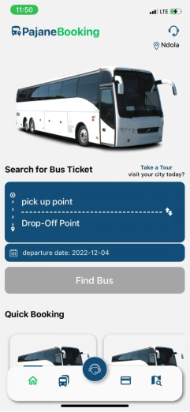

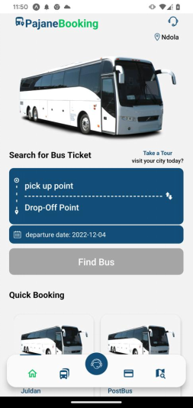
Research Results and Analysis
How the system meets objectives
Objective 1: To develop a cross platform bus booking Ticket system.

Slide 19
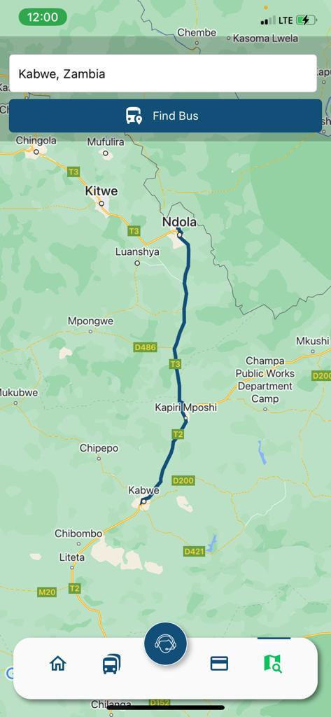
Cont...
Objective 2: To integrate Google maps APIs to reduce the time complexity of booking a bus ticket at bus terminus in zambia.
The system is integrated with Various Map SDKs that can enhance the searching and visualization of routes and city artifacts

Slide 20
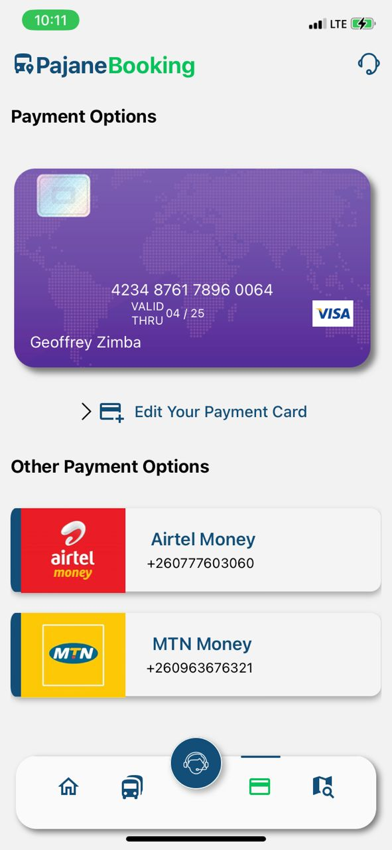
Cont...
Objective 3: To integrate multiple payment methods in the cross platform bus booking ticket system.
The system supports various gateway platforms such as MTN, Airtel, and Zamtel.

Slide 21
Conclusion
The development of a mobile application for bus booking ticket systems is a major advantage and indeed a helpful technology tool to help in the transport industry, particularly the bus transport sector, which is very important in Zambia, thus the Pajane mobile application is a must do and is the solution to the physical challenges encountered at bus-stations by clients, e.g., physically moving just to secure and reserve a seat;
From the reviewed system ALL1ZED our system is not a multi facilitated application for all types of bookings but a single purpose application to facilitate bus booking for coach bus tickets in zambia

Slide 22
Recommendations
For the system developed a number of components which are recommended for future works including maintenance to ensure that customer satisfaction and management of the system is prioritized and maintained. The system lucks an operator end Application which will be used to scan for bus tickets and schedule buses as well as creating of routes for easy operations and privilege granting. The System Carries a lot of components that my be of great complexity and need enough human and financial resources such hence the team failing to implement the other side of the application

Slide 23
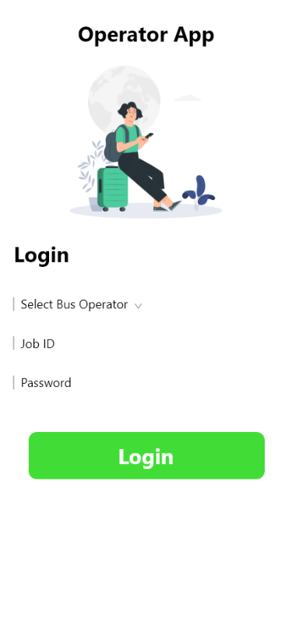
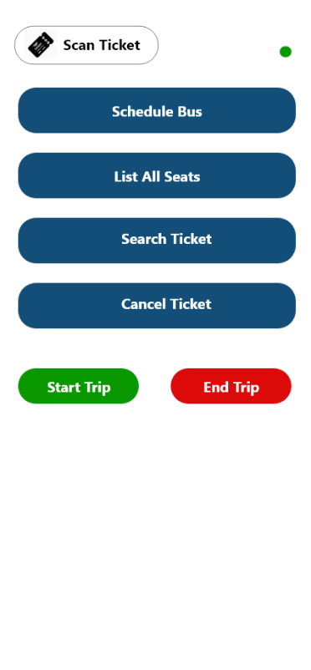
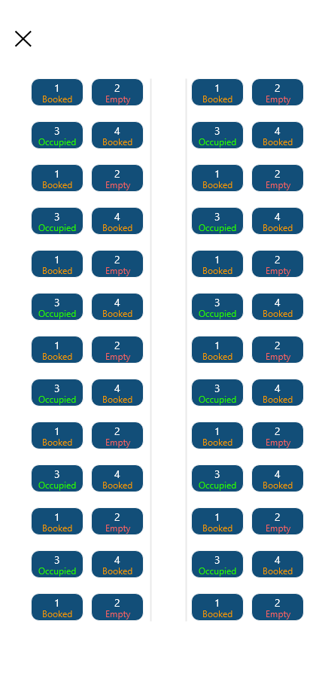
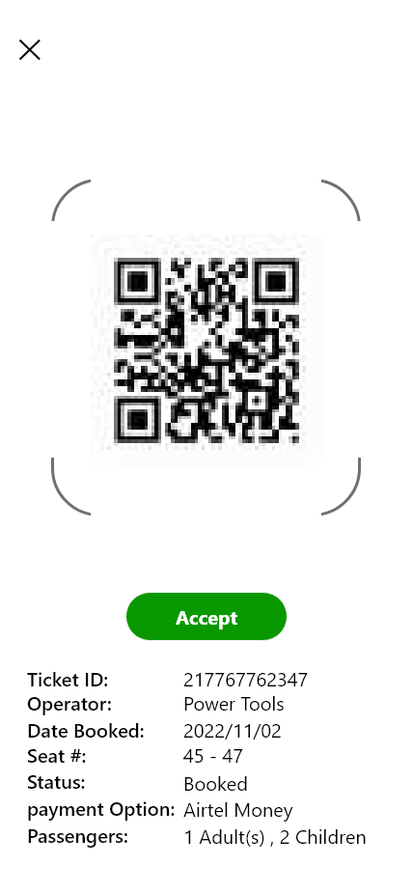
Opertor end app

Slide 24
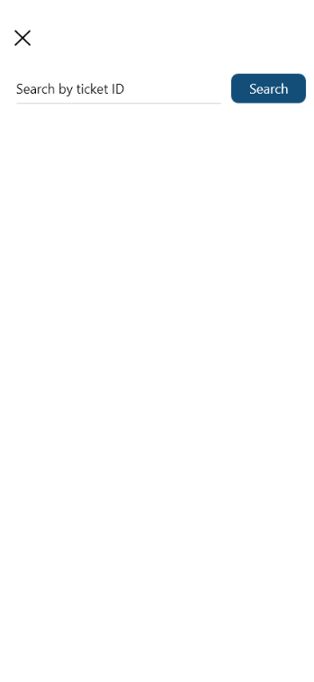
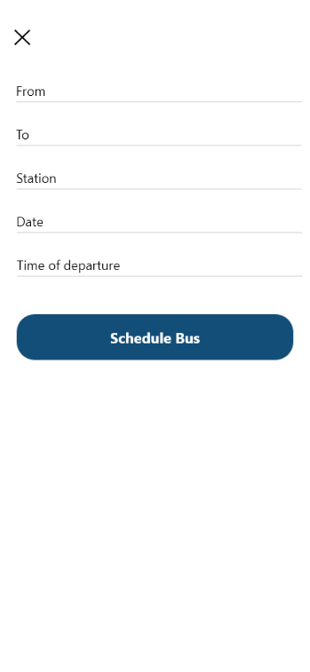


Slide 25
Thank You

